Slide 1
DigitalLabs@MMU Live Projects Team Setup

Slide 2

Have you Registered?
Image credit: Tory Townsend

Slide 3
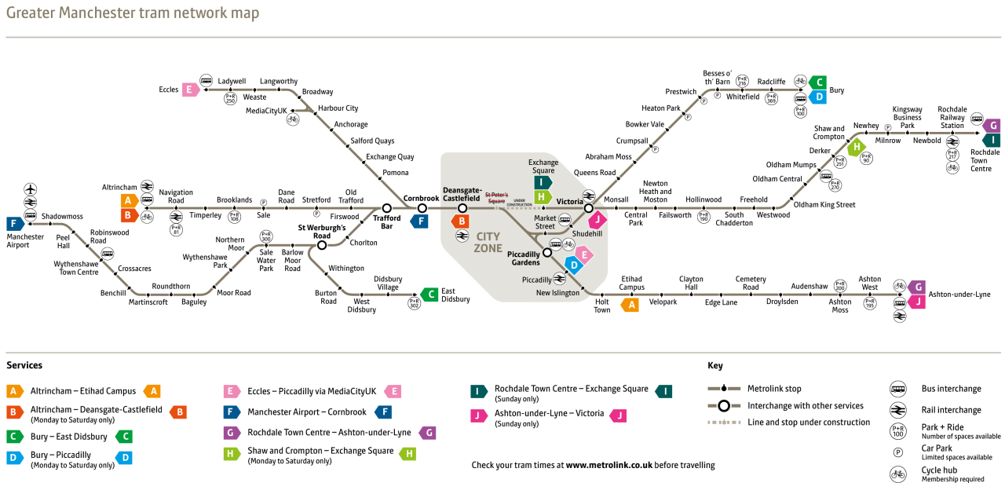
Today
Hello!
Registration
The Plan
16Personalities.com
Set up your team
Strengths and Weaknesses
Communication Roles
Project Identity
Setup the project
Alice
Trello
GitHub
Source Tree
Base Project
Do your effort budget
The resource planning tool
Ideas
Start to investigate
Plan your investigation
Next Time
Notes:
b

Slide 4
Follow Along!
Go to:
www.github.com/alicedigitallabs
Click on:
SupportingLiveProjects_2017
Click on:
Find file
Type:
workshop1
This file is:
docs/workshops/WORKSHOP1_TEAMSETUP/team_setup.pptx
Download the file to your desktop and open it.

Slide 5
Hello!
Image credit: Tory Townsend

Slide 6

DigitalLabs@MMU
Hello!
Laurie Cooper
Dave Mee
Stuart Bennet

Slide 7
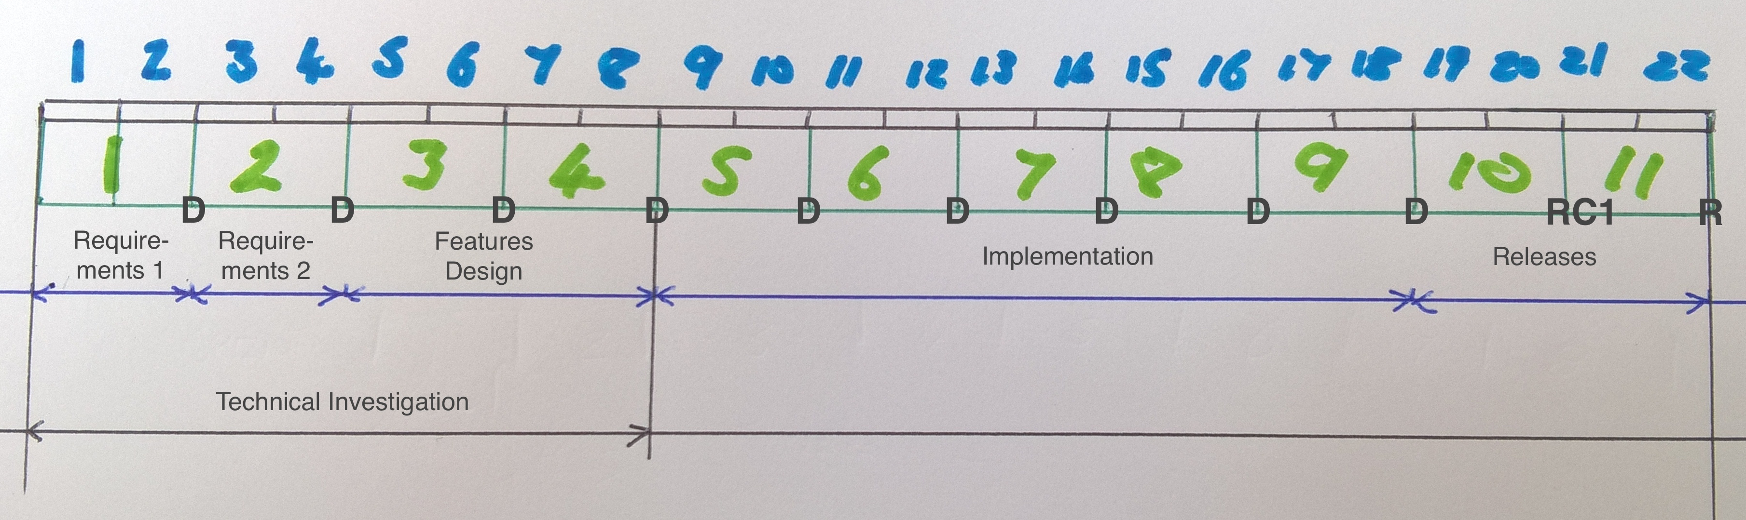
The Plan
Object: Produce an MVP from a client brief in 22 weeks
Phases:
Prep
Implementation
Release
Regular short sprints and deliveries

Slide 8
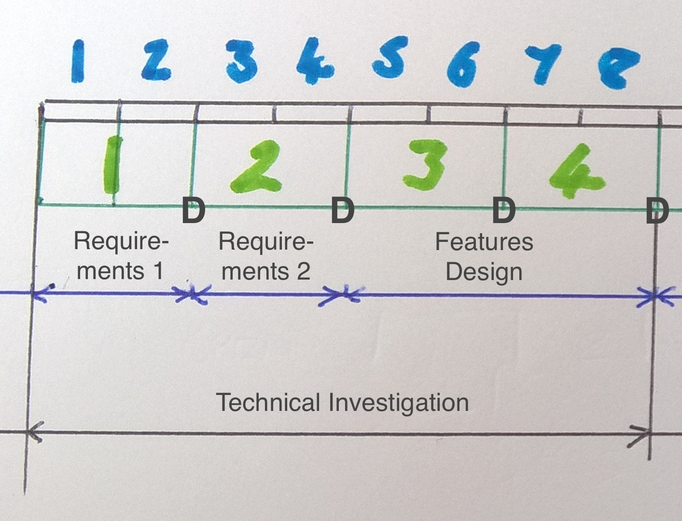
The Plan
Prep:
Timescale:
8 weeks, 5 workshops, 4 deliveries.
By the end:
A workable, achievable design.
More Information?
See your hand-out.

Slide 9
Set-up
Your
Team
Image credit: Tory Townsend

Slide 10
Setup Your Team
Go to:
16personalities.com
Click on:
‘Take the Test’
You have 12 minutes!

Slide 11
Setup Your Team
Caveats:
The outcome is not a label
You don’t have to share the outcome

Slide 12
Setup Your Team
About You:
Look at:
Introduction
Strengths and Weaknesses
Workplace habits

Slide 13
Setup Your Team
Communications / Admin Roles:
Responsible for:
Collating / communicating project status
The integrity of the project documentation
Making the delivery
Project Manager
Responsible for
Collating / communicating the design
The integrity of the repo
Making the delivery
Technical Lead

Slide 14
Setup Your Team
Communications / Admin Roles:
Discuss and
Nominate your
Project Manager
and
Tech Lead
Roles

Slide 15
Set-up
The
Project
Image credit: Tory Townsend

Slide 16
Setup The Project
Project Identity
Gmail address
Allows the ‘project’ to do the investigation
All transactions on behalf of the project are kept in one place
Resulting SPAM is kept away from you
Ideal form of communication to DigitalLabs
Can pass the project account on

Slide 17
Setup The Project
Project Identity
Project Managers:
Create a Gmail Address for the project
Be aware of namespace pollution:
Example:
LiveProject_2017_TeamGreen@gmail.com

Slide 18
Setup The Project
Project Identity
Use the project identity to:
try out free-tier platforms and services
communicate with DigitalLabs - Alice

Slide 19

Setup The Project
Alice
Alice is DigitalLabs’ Support Entity:
Contact Alice using your project identity
Project Managers only
Anyone else: if it’s urgent, come to the shed

Slide 20
Setup The Project
Alice
Project Managers:
Send a message to Alice, using your Project Identity

Slide 21
Setup The Project
Alice
Project Managers:
Send a message to Alice, using your Project Identity

Slide 22

Setup The Project
Trello
We use Trello
Ridiculously easy to use
Lists of cards
Cards hold information (markdown, pictures, links, etc)
Clever plugin to help estimate effort: Scrum for Trello
Image credit: Caylakwiki

Slide 23
Setup The Project
Trello
Project information in the early stages of the project
Project Overview
Project Status
Brainstorming
User Stories
Feature cards
Component Descriptions
Wireframe images
Track Project Progress during implementation phase

Slide 24
Setup The Project
Trello
Everyone:
Sign-up to Trello

Slide 25
Setup The Project
Trello
Project Managers:
Create a Team
Use the same name as your Project Identity
Invite Team Members to the Trello Team

Slide 26
Setup The Project
Trello
Project Managers:
Create a board: Project Overview
Use the same name as your Project Identity
Invite Team Members to the board
Invite Alice to the board
alicedigitallabs

Slide 27
Setup The Project
Trello
Project Managers:
Project Overview
Create a list: ‘Resources’
Add a card: ‘Project Identity’
In the card: Write the login details to the Project Gmail account.

Slide 28
Setup The Project
Trello
Project Managers:
Project Overview
Create a list: ‘Team’
Add a card: ‘Project Manager’
In the card: Write the name of the project manager
Add a card: ‘Technical Lead’
In the card: Write the name of the tech lead
Add a card: ‘Members’
In the card: names of team members
In the card: email addresses of team members

Slide 29
Setup The Project
Trello
Project Managers:
Create a board: Workshop 1
Invite Team Members to the board
Invite Alice to the board
alicedigitallabs

Slide 30
Setup The Project
Trello
Project Managers:
Workshop 1
Create a list: ‘Resources’
Add a card: ‘Brief’
Add your brief pdf to the card

Slide 31

Setup The Project
GitHub
Everyone:
Sign-up to GitHub

Slide 32
Setup The Project
GitHub
We use Github
Document repository
De-facto place for open source projects and example code
Multiple people working on many documents at the same time
Check-in, check-out documents
Merge other people’s changes
As easy as it can be
Image credit: GitHub

Slide 33
Setup The Project
GitHub
Project Managers:
Create an organisation
Use the same name as your Team – if possible
Invite Team Members to the organisation
Invite Alice to the organisation
AliceDigitalLabs

Slide 34
Setup The Project
GitHub
Project Managers:
Create a repository
Use the same name as your Project Identity
Make sure that the organisation owns the repo

Slide 35
Setup The Project
GitHub
Everyone:
Check you can see the organisation
Check you can see the repo

Slide 36
Setup The Project
GitHub
This is your Base Repository
You will probably need to create more repos
If you do, document what they are and what they do, check this information into your base repo.

Slide 37

Setup The Project
Source Tree
We use Source Tree – as an easy Github UI
Image credit: Source Tree

Slide 38
Setup The Project
Source Tree
Everyone:
Download and install Source Tree

Slide 39
Setup The Project
The Base Project
This is a basic file structure which will help you stay organised.

Slide 40
Setup The Project
Source Tree
Everyone Follow Stuart:
Hands Up! Who wants Stuart to set-up their repo as a demo?
You other teams need to follow along…

Slide 41
Setup The Project
Source Tree
Follow Stuart (Part 1) : Everyone
Lucky Team: Invite Stuart to your Repo
Stuart + Everyone:
GitHub site: Join the Repo
GitHub site: Repo shortcut to clipboard
Make a folder on your local filesystem
/<user>/projects/your_project_name/
Source Tree: join remote repo
Source Tree: pull repo
Check repo is now on your local filesystem

Slide 42
Setup The Project
Source Tree
Follow Stuart (part 2): Tech Leads
Stuart:
Download project_template.zip
Unpack project_template.zip in local project structure
Source Tree: check-in base project

Slide 43
Setup The Project
Source Tree
Follow Stuart (part 3): Everyone
‘Pull’ the changes

Slide 44
Setup The Project
Source Tree
Everyone
You now have one repo connected
You can have many repos connected
Try some tutorials
You MUST be familiar with GitHub, Trello, SourceTree
AS SOON AS POSSIBLE

Slide 45
Setup The Project
Source Tree
Project Managers
Look after Trello. See that it is kept tidy
Technical Leads
Look after the Project Repo. See that it is kept tidy
Explore the filestructure. Learn what goes where.
Learn how to check-in / check-out
Do the tutorials. Pass the knowledge on.

Slide 46
The Effort Budget
Image credit: Tory Townsend

Slide 47
The Effort Budget
The Plan:
Object: Produce an MVP from a client brief in 22 weeks
Phases:
Prep
Implementation
Release

Slide 48
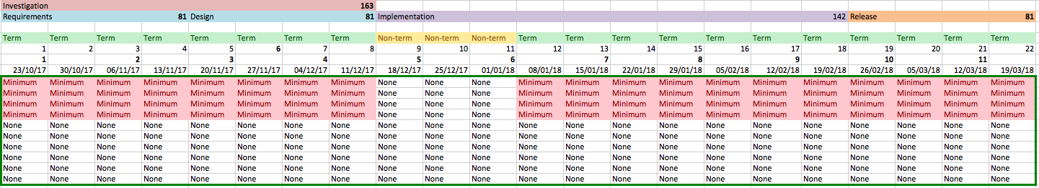
The Effort Budget
The Spreadsheet:
You can find this locally in: <your_project_name>/docs/budget, but we will use it on-line right now.

Slide 49
The Effort Budget
The Spreadsheet:
Project Managers
Sign-in to the Project Identity on Google
Go to Google Sheets
Create a new Spreadsheet
Import…
Upload…
Drag the <your_project_name>/docs/budget/effort_committment.xlsx onto the upload area
The spreadsheet imports

Slide 50
The Effort Budget
The Spreadsheet:
Project Managers
Change Member Names on the Sheet
Invite your Team Members to the Sheet
(Use your Trello Board to give you contact information)
Invite Alice to the Sheet

Slide 51
The Effort Budget
The Spreadsheet:
Everyone
The sheet is a representation of how much effort is available from the whole team over the project
It helps with budgeting
As you get more understanding of the technologies you will be using, you can estimate how much functionality you will put into your app.
For more guidance, see the handout

Slide 52
The Effort Budget
The Spreadsheet:
Everyone
Fill In the Sheet!
How many hours have you got?
Discuss some common activities (Like installing a dev system)
Think about what you can get done in a week
Think about what your team can get done in a week

Slide 53
The Investigation
Image credit: Tory Townsend

Slide 54
The Investigation
Ideas:
Project Managers
Go to the Trello board: ‘Workshop 1’
Create a List called Investigations
Create a List for each week of the investigation phase

Slide 55
The Investigation
Ideas:
Everyone
Go to the Trello board: ‘Workshop 1’
Brainstorm - discuss:
The brief
Technologies you might be using
Investigations they might need.
Use the Trello board to organise your thoughts

Slide 56
The Investigation
Plan your investigation:
Everyone
Go to the Trello board: ‘Workshop 1’
There are 4 deliverables
The first Deliverable is at the end of Sprint 1
See the Handout for details.
If your project has specific hardware requirements come and see us.

Slide 57
The Investigation
Deliverable
Project Manager is responsible for delivery
“Requirements 1: Team Response to the Brief”
Markdown Text Document, checked into your Repo
Email the URL. See the how-to here.
Evidence:
Code samples / worklogs checked into your repos
We are looking for your first stab at understanding what of the brief is achievable, and how.

Slide 58
The Investigation
Deliverable
The first Deliverable is at the end of Sprint 1
Project Manager is responsible for delivery
“Requirements 1: Team Response to the Brief”
Markdown Text Document, checked into your Repo
Email the URL. See the how-to here.
Evidence:
Code samples / worklogs checked into your repos
We are looking for your first stab at understanding what of the brief is achievable, and how.

Slide 59
The Investigation
Next Time
The next workshop date and time is available here:
Any hardware should be available.
We will be helping ready you for delivery of 1st Draft Requirements.

